Slide 1
EMPLOYEE MANAGEMENT SYSTEM
Presented By
Dileep Thoti

Slide 2
What is EMS ..??
Employee Management System is a Full stack application developed to maintain the details of employees in any organization.
It maintains the personal and official details of employees.
This project is used to simplify the task of maintaining records of employees of the company.

Slide 3
Functionalities
Records are maintained in the database.
Create new users to the system accordingly.
We can search and update the user details in the database.
Maintains the records and also backup of database for a longer time.

Slide 4
advantages
Provide a computerized system for maintaining records.
More efficient and reliable.
Less Time consuming and Easy to use.
Avoid Human errors and huge efforts for maintaining employee data.

Slide 5
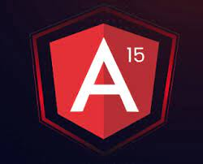


Technologies Used
Angular framework for frontend development.
Spring boot + MySQL for backend development.

Slide 6

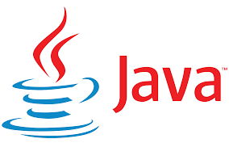
Programming Languages
HTML5, CSS3, TypeScript for frontend.
Java for backend Development.
SQL for Database.

Slide 7
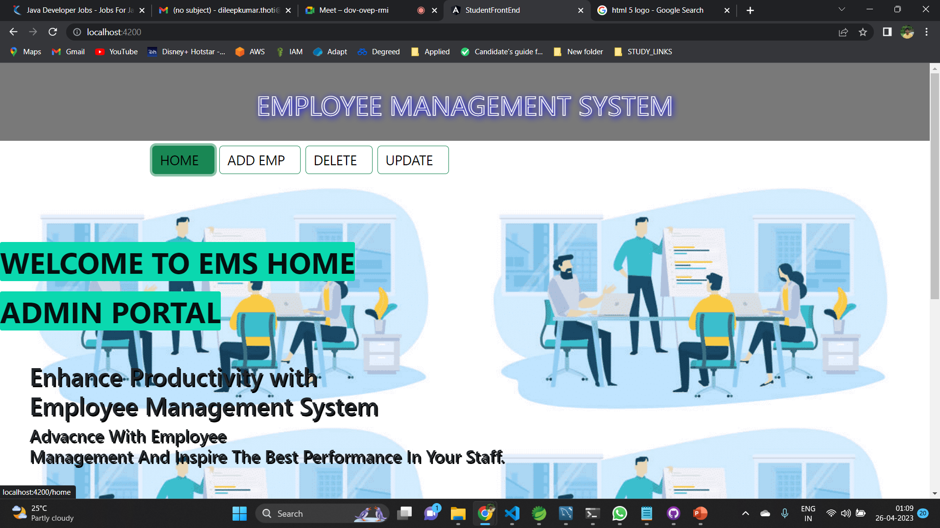
Home page

Slide 8
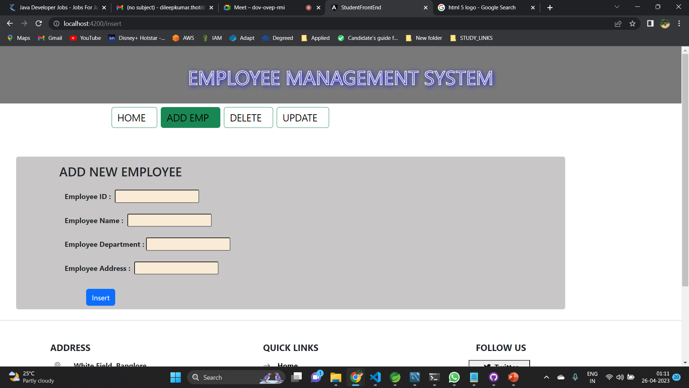
Insert new Employee

Slide 9
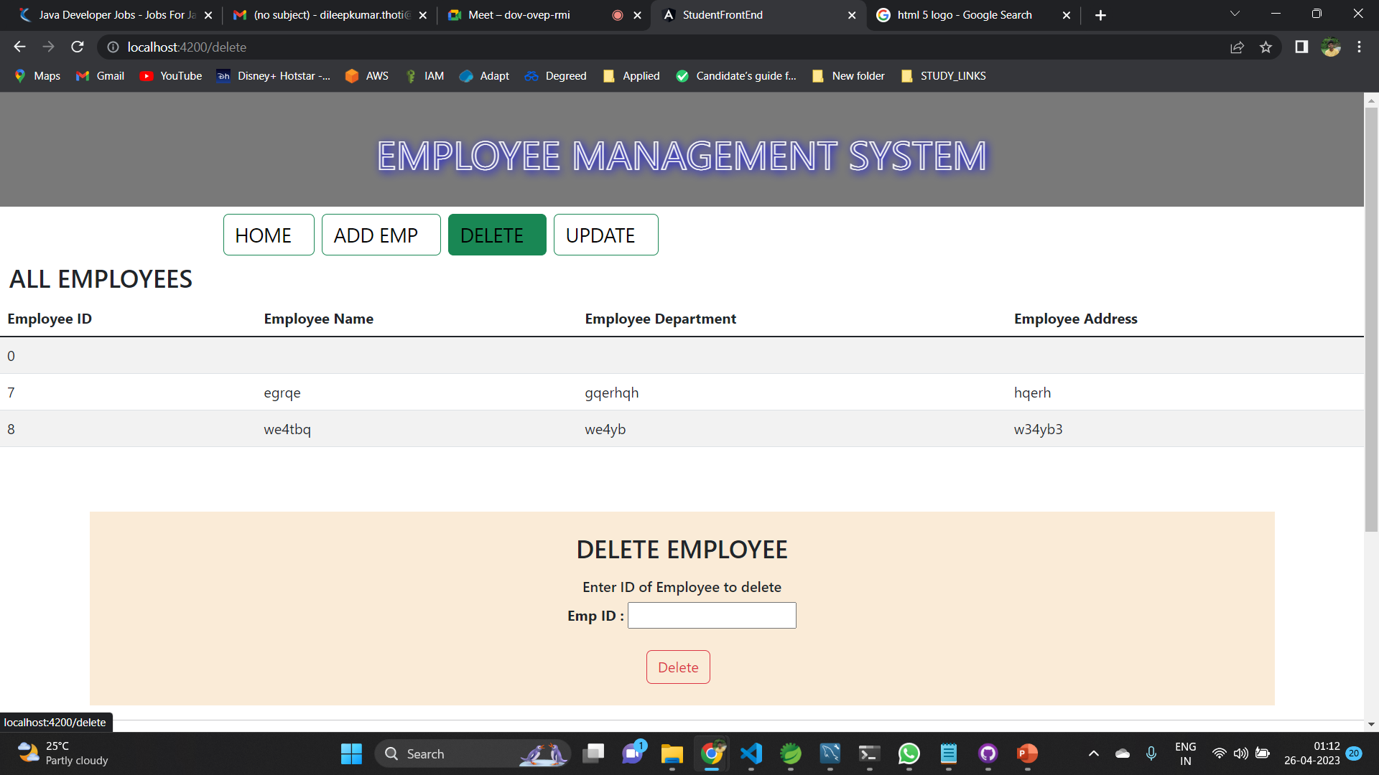
VIEW and delete EMPLOYEES

Slide 10
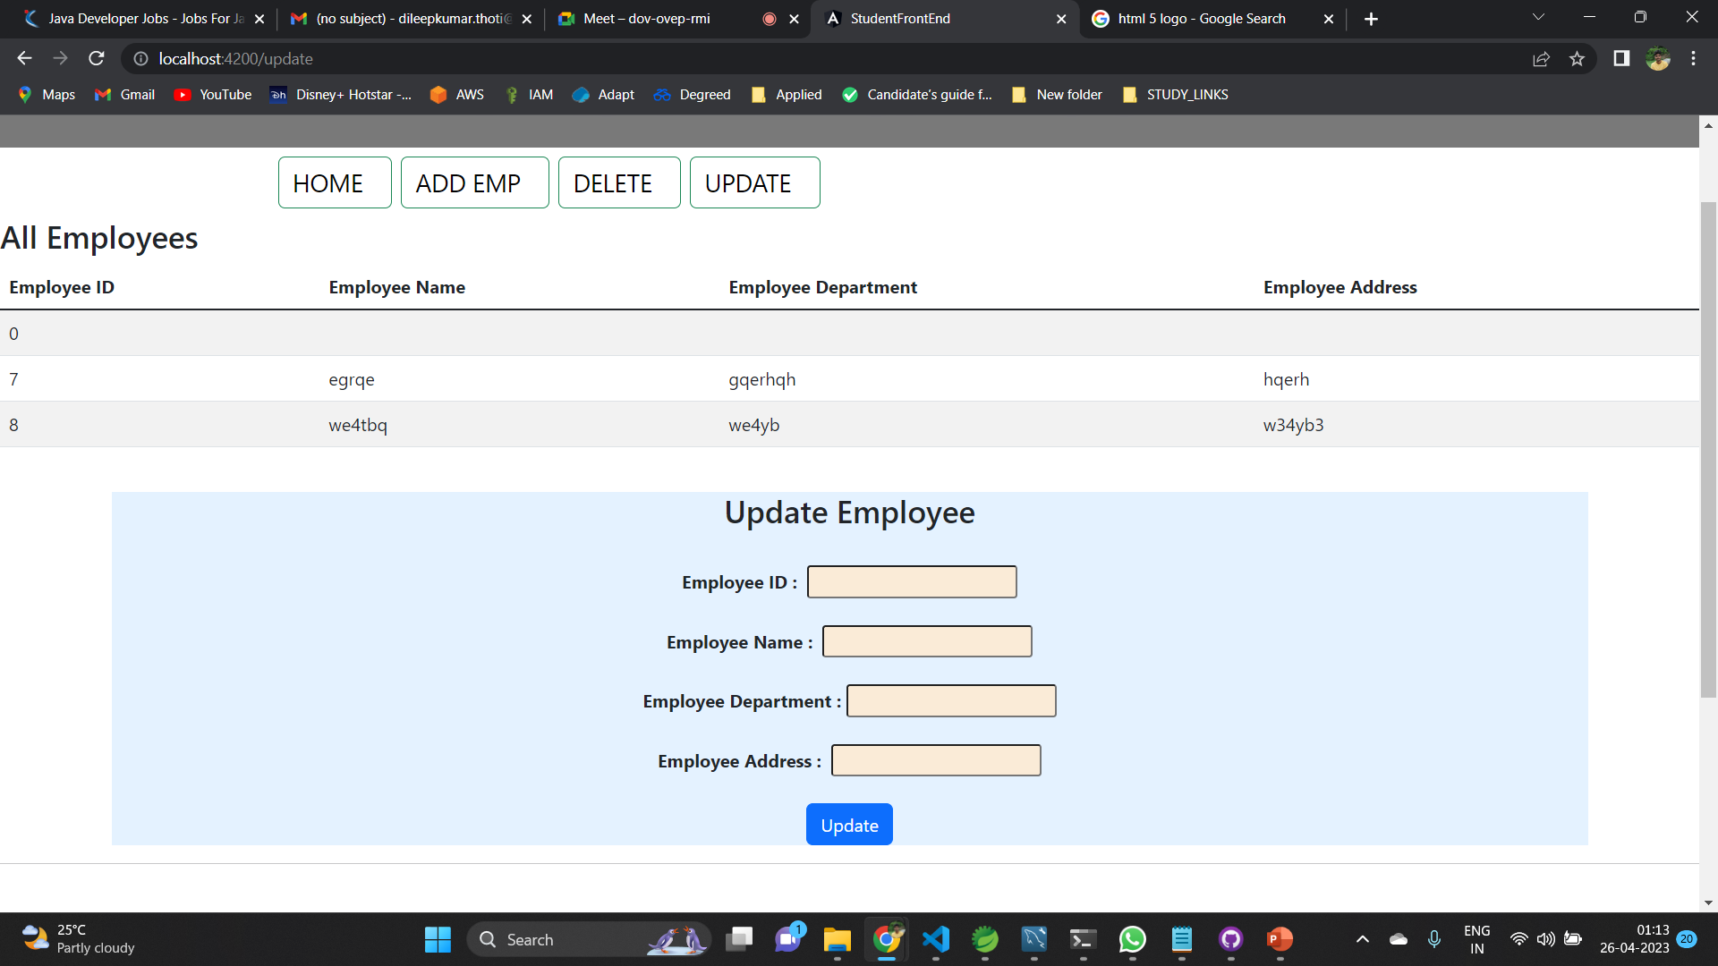
Update employee

Slide 11
Thank you!

